Slide 1

Home Inspection (驗屋)
Presented by Edward Tsang (曾慶樂)
(License # (牌照號碼): 80018)

Slide 2
Code of Practice (業務守則)
Inspect readily accessible, visually observable, installed systems and components (目測易進入之已安裝的系統和設備);
Provide a written report stating (提供書面報告, 說明):
(i) Those not functioning, deficient, unsafe
or near end of services life (系統和設備的
故障, 損壞, 不安全或接近使用壽命期限);
(ii) Recommendations (建議);
(iii) Implications (可能引致之後果);
(iv) Limitations (限制)

Slide 3
Scope of Inspection (驗屋範圍)
Roof (屋頂)
Exterior (外部)
Structural (結構)
Electrical (電氣)
Heating and Cooling (暖氣及空調)
Plumbing (水務)
Insulation (保温)
Interior (內部)

Slide 4

Roof Systems (屋頂系統)
Roof Coverings (屋頂瓦面)
Roof Flashings (屋頂防水板)
Chimneys, Skylights and Roof Penetrations
(煙囪, 天窗及其他屋頂附件)
Roof Drainage Systems (屋頂排水系統)

Slide 5
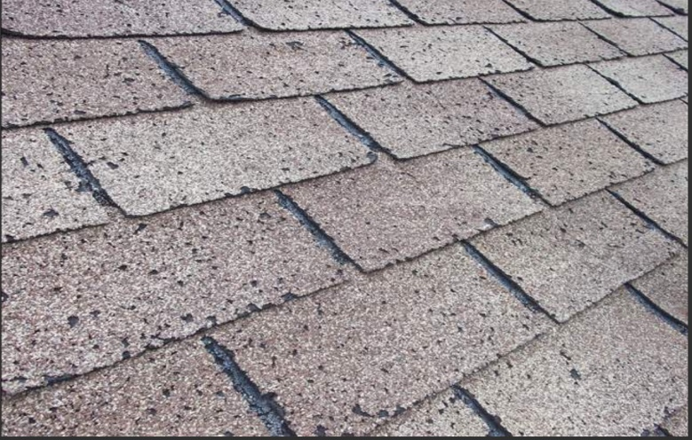
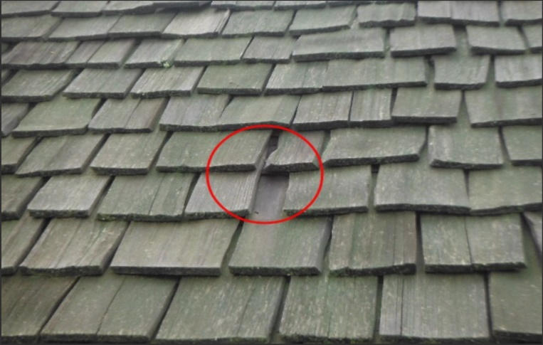
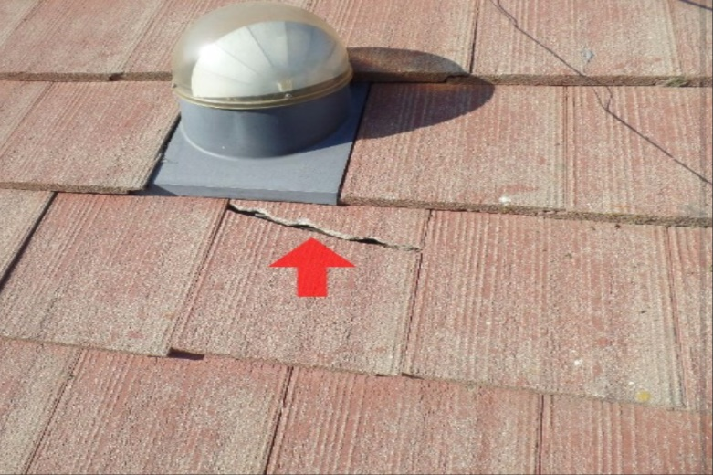
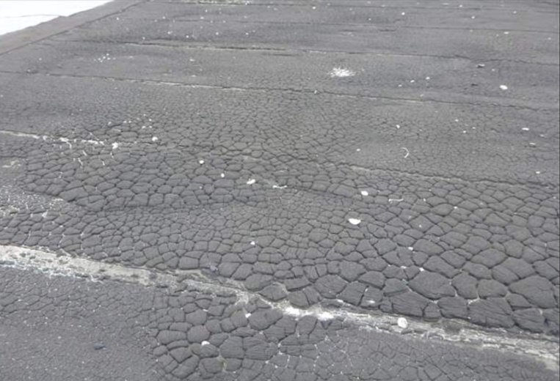
Roof Covering Defect Examples
(瓦面損壞例子)
Near end of life (接近壽命期限)
Missing/Curling/Splitting (甩掉/捲曲/爆裂)
Cracking (裂開)
Alligatoring (龜裂)

Slide 6
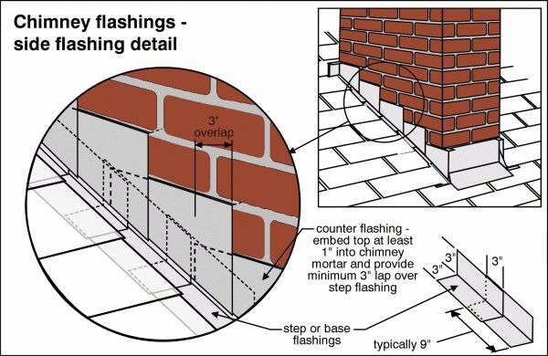
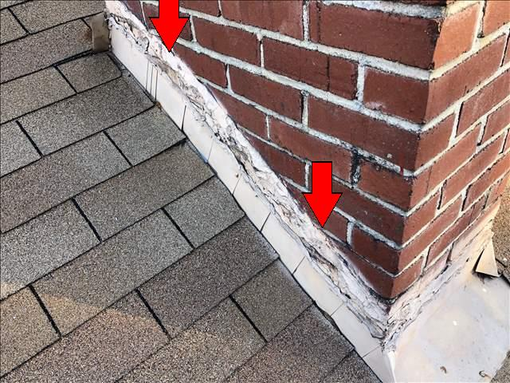
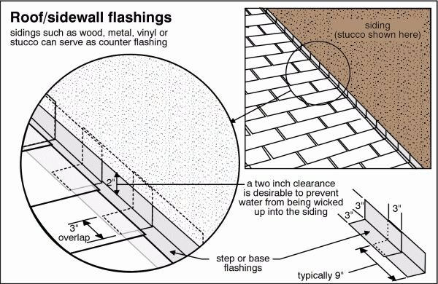
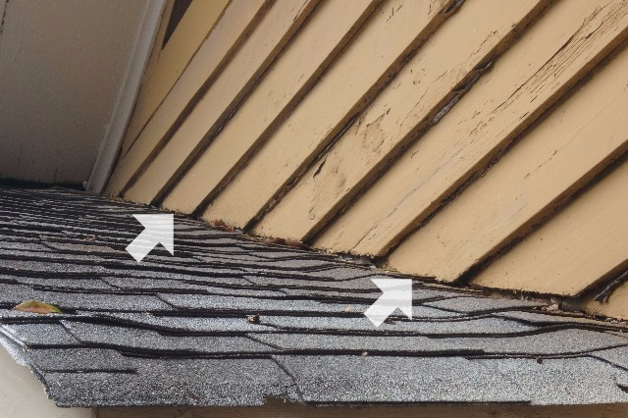
Roof Flashing Defect Examples
(屋頂防水板損壞例子)
Proper installation (正確安裝)
Not into mortar joints (未嵌入接合處)
Proper installation (正確安裝)
No clearance (沒有两吋間隙)

Slide 7
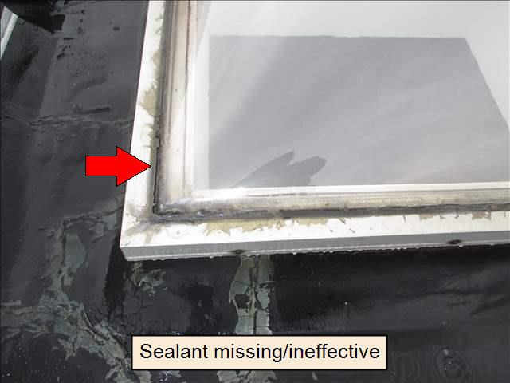
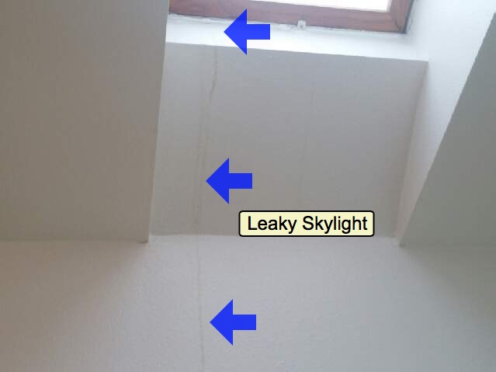
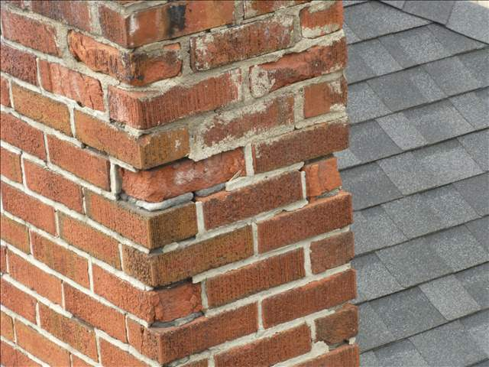
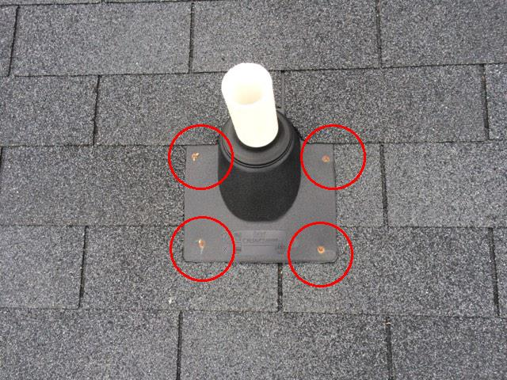
Chimney/Skylight/Penetration Defect Examples
(煙囪/天窗/屋頂其他附件損壞例子)
Skylight sealant defective (天窗密封 膠損壞)
Skylight leaks (天窗漏水)
Chimney wall damaged (煙囪牆身損壞)
Exposed nail heads (釘頭外露)

Slide 8
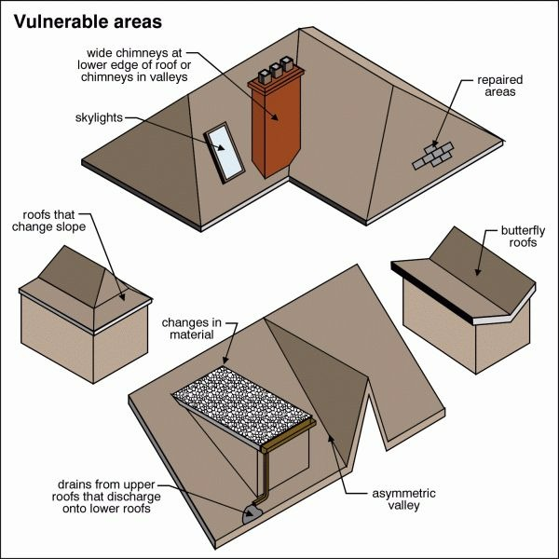
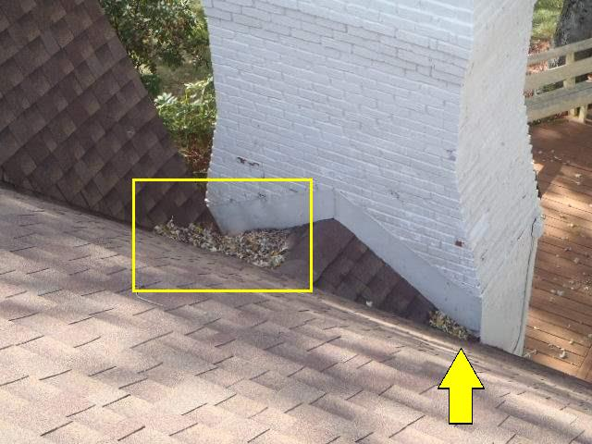
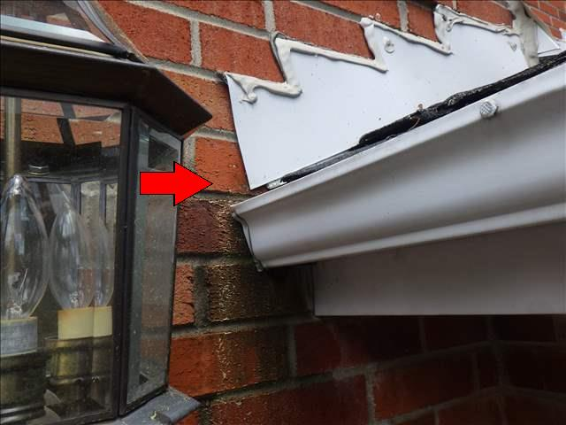
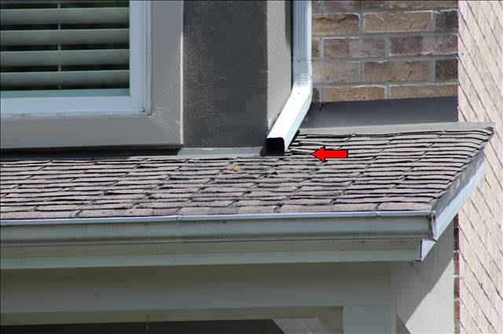
Roof Drainage System Defect Examples
(屋頂排水系統損壞例子)
Vulnerable areas (易損壞之處)
Vulnerable areas (易損壞之處)
No Kickout flashings (缺少導引防水板裝置)
Discharge on roof (卸水流經屋頂)

Slide 9
Exterior Systems (外部系統)
Exterior Wall (外牆)
Doors/Windows Exterior Side (門窗外部)
Decks/Balconies/Steps (露天平台/陽台/外部梯級)
Soffits/Fascias/Trims (屋簷/護板)
Lot Grading/Surface Drainage (地勢/排雨水系統)
Landscaping (樹木)
Driveways/Walks/Patio (車道/人行道/天井)
Retaining Wall (擋土牆)
Garage/Carport (車庫)

Slide 10
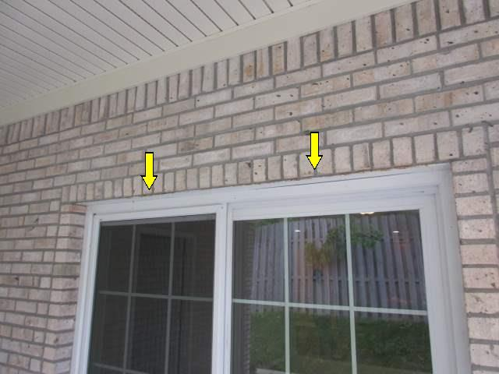
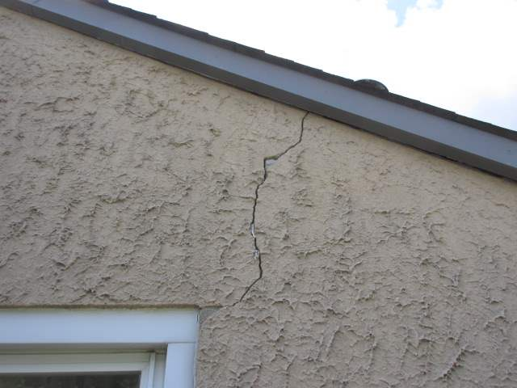
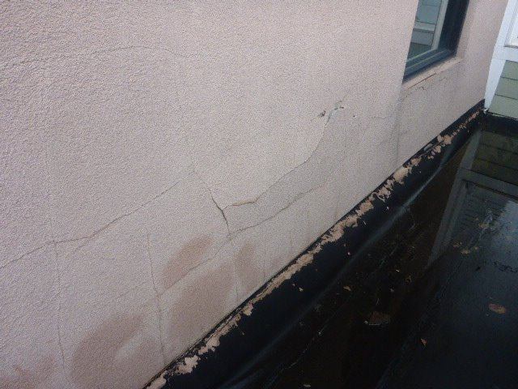
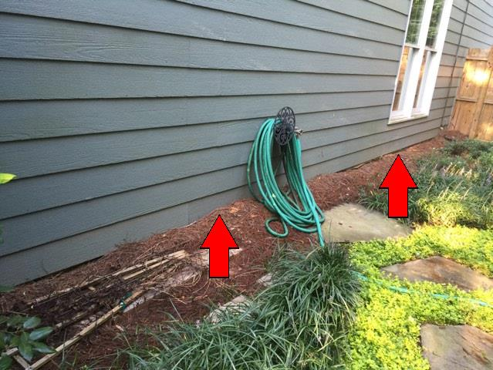
Common Exterior defects (1)
(常見外部系統毛病) (1)
Brick wall no weep hole (磚牆缺少淚孔)
Stucco wall crack (灰泥牆有裂痕)
Stucco wall moisture in (灰泥牆水氣滲入)
Too close to grade (牆身太接近地面)

Slide 11
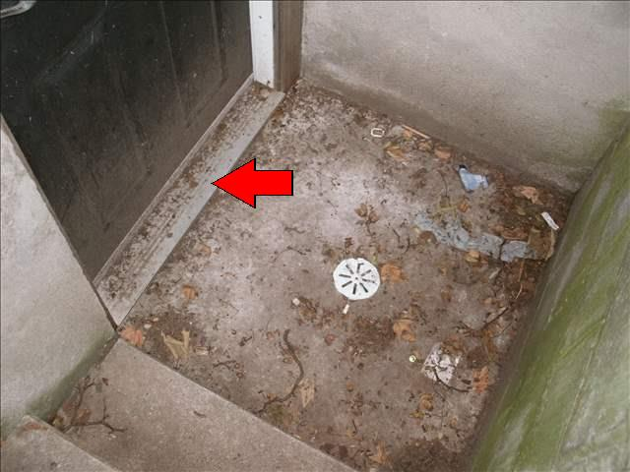
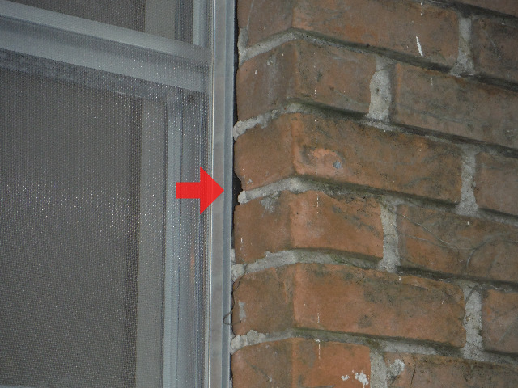
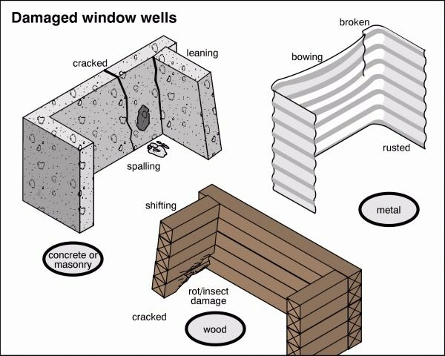
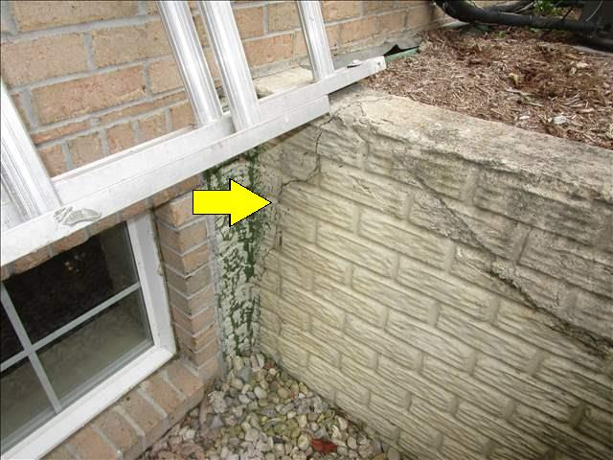
Common Exterior defects (2)
(常見外部系統毛病) (2)
Door threshold too low (門檻太低)
Window caulking ineffective (窗框堵縫失效)
Damaged window well (窗井損壞)
Well wall damaged (窗井牆損壞)

Slide 12
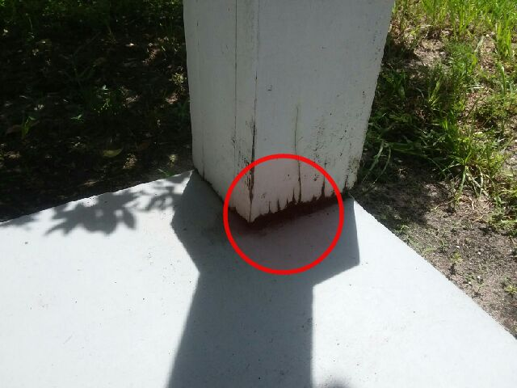
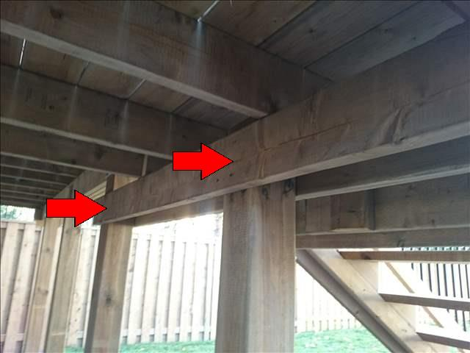
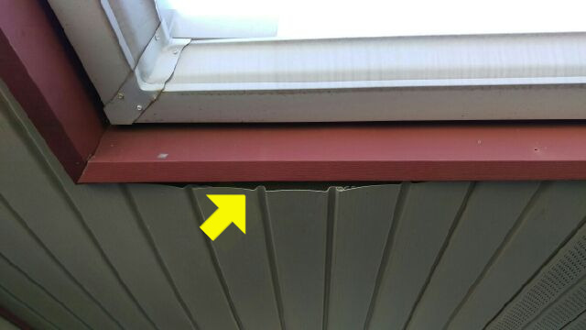
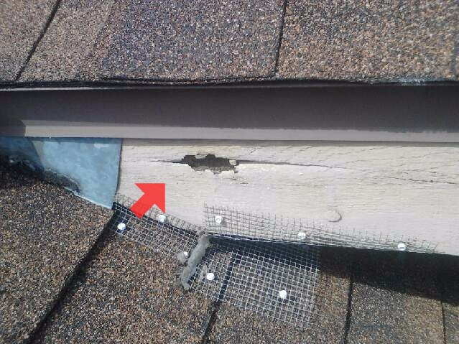
Common Exterior defects (3)
(常見外部系統毛病) (3)
Deck post rot (平台支柱腐爛)
Deck support inadequate (平台支撑不足)
Soffit loose (屋簷底模鬆脫)
Fascia board rotted (封檐板腐爛)

Slide 13
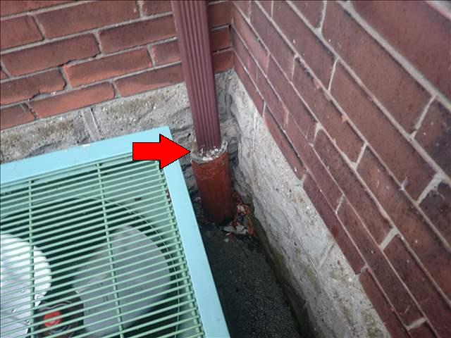
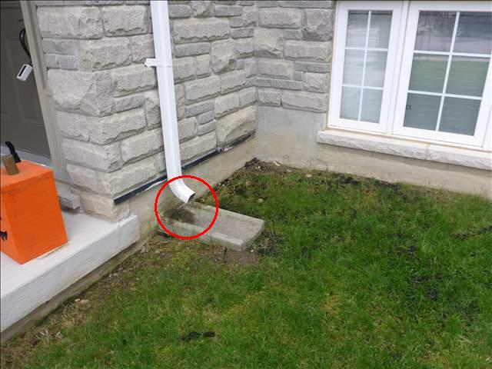
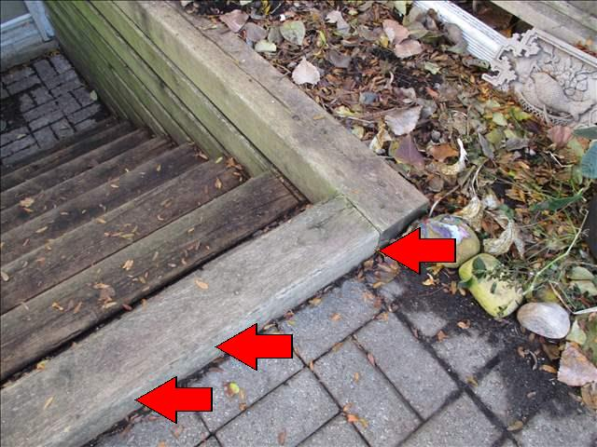
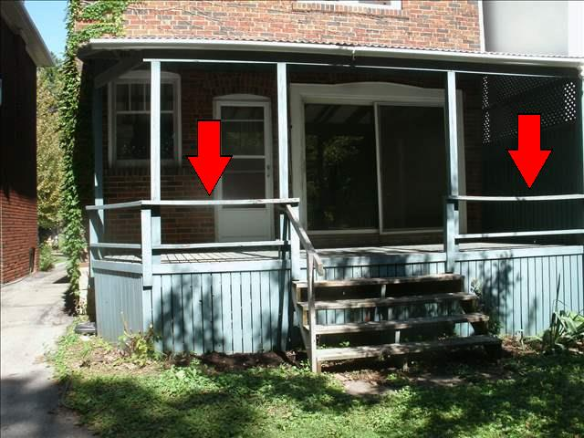
Common Exterior defects (4)
(常見外部系統毛病) (4)
Old perimeter drain tile (陳舊外圍排水瓦通)
Discharge too close (排水離屋太近)
Walkway trip hazard (人行道有絆倒危險)
Railings ineffective (圍欄失效)

Slide 14
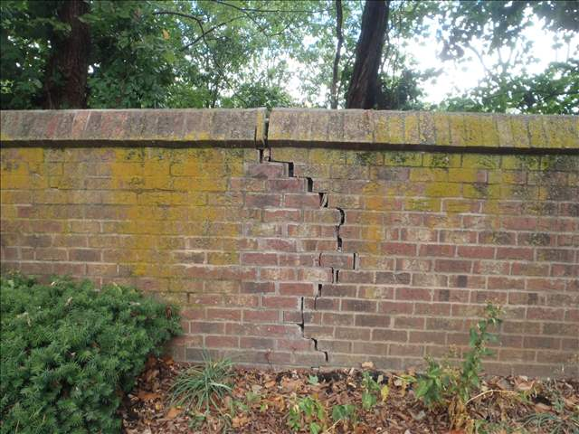
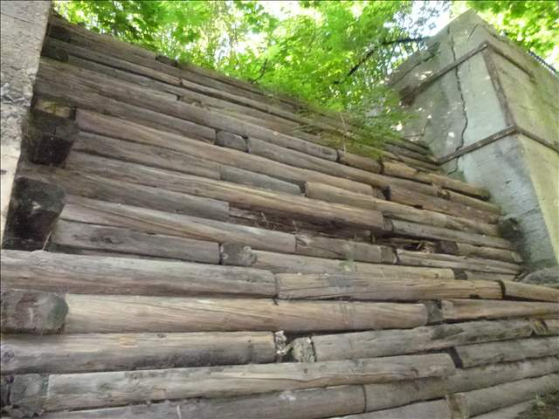
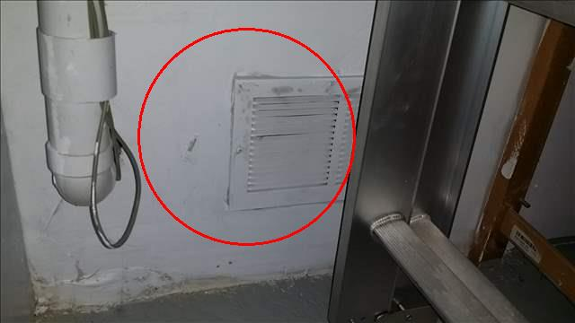
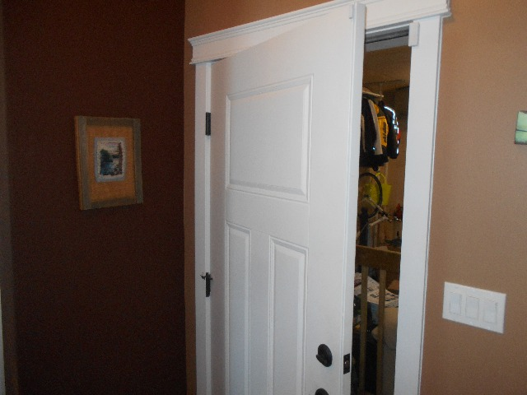
Common Exterior System Defects (5)
(常見外部系統毛病) (5)
Retailing wall leaning (擋土牆傾斜/爆裂)
Retaining wall rotted (擋土牆腐爛)
Garage gastight damaged (車房氣密削弱)
Mandoor not self-closing (人門不自動全關)

Slide 15
Structural Systems (結構系統)
Foundation Structure (地基結構)
Floor Structure (地板結構)
Wall Structure (牆壁結構)
Ceiling Structure (天花結構)
Roof Structure (屋頂結構)

Slide 16
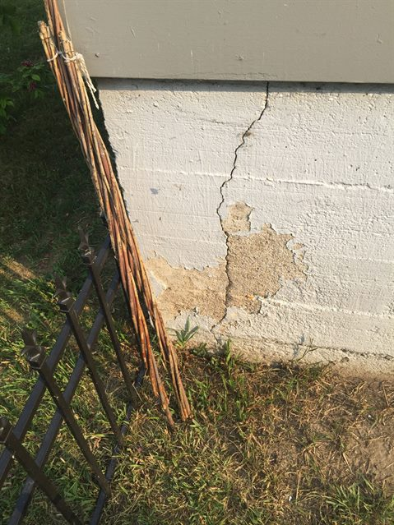
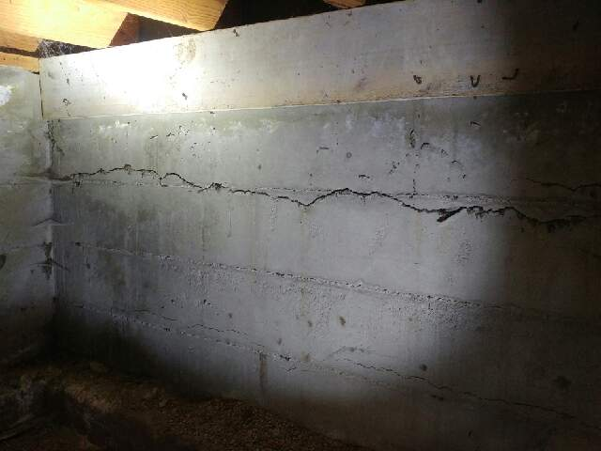
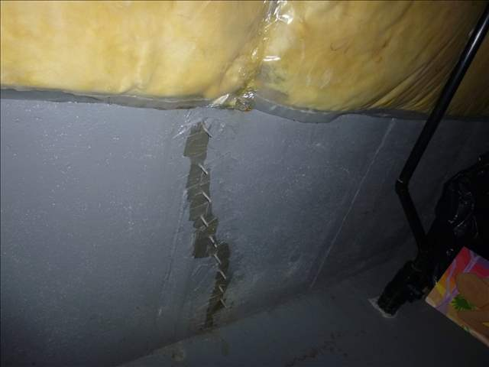
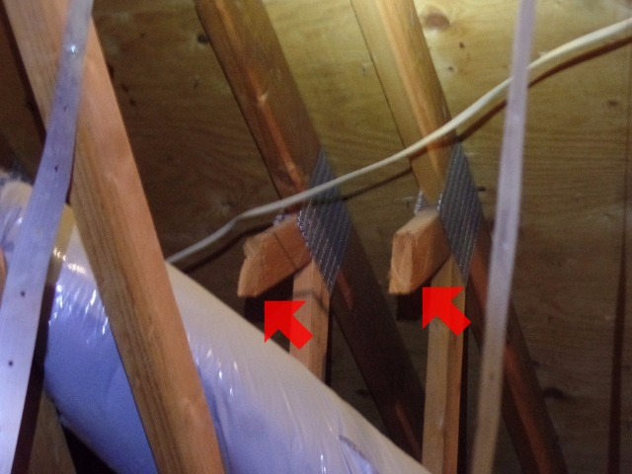
Common Structural System Defects
(常見結構系統毛病)
Vertical crack (垂直裂縫)
Horizontal crack (水平裂縫)
Prior repair (先前維修)
Cut truss (切斷屋頂椽子構架)

Slide 17
Electrical Systems (電氣系統)
Service Lines (供電線路)
Service Entrance Conductors (供電導體)
Service Equipment/Main Disconnect (總開關)
Service Grounding (接地裝置)
Service Panel/Subpanel (供電掣箱)
Distribution Conductors (分配電力導體)
Over Current Protection (超載保護裝置)
Lightings/Switches/Receptacles (電掣/插座)
GFCI/AFCI (漏電/電弧斷流器)

Slide 18
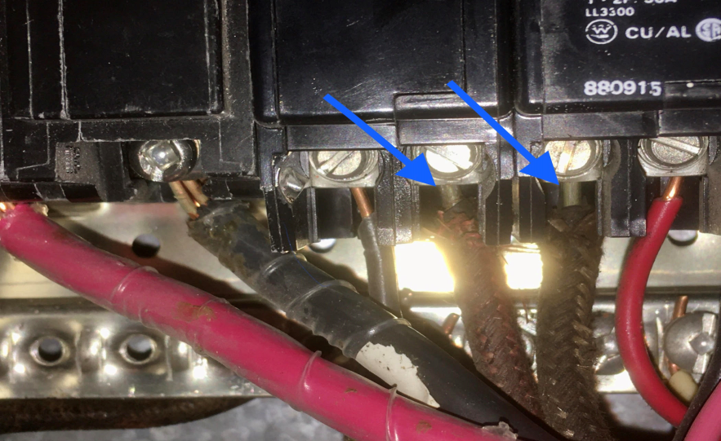
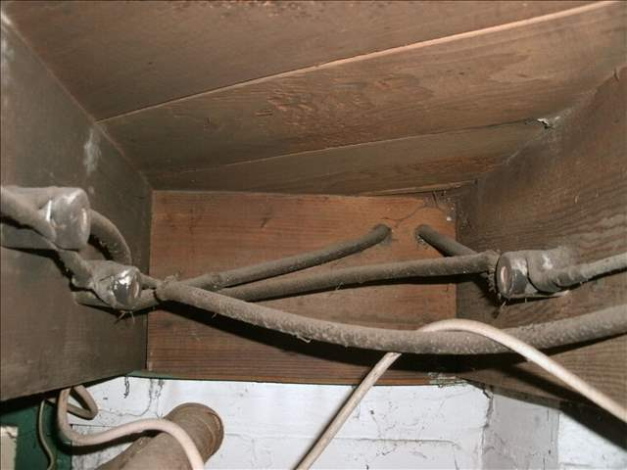
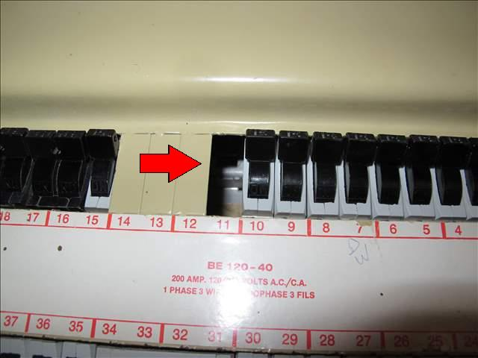
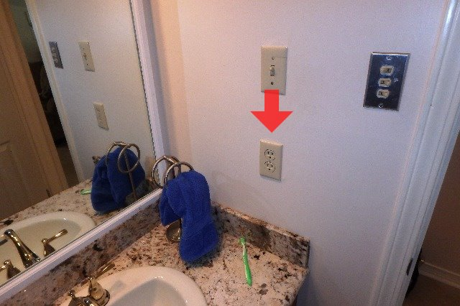
Common Electrical System defects
(常見電氣系統毛病)
Single core aluminum wire (單枝鋁線)
Knob-and-Tube wiring (瓷珠瓷管佈線)
Unprotected opening (無保護的開口)
GFCI missing (無漏電保護器)

Slide 19
Heating Systems (供暖系統)
Fuel Storage Systems (燃料儲存系統)
Fuel Distribution Systems (燃料分發系統)
Installed Heating Equipment (加熱設備)
Vent Systems/Chimneys (排氣系統/煙囪)
Ductworks and Registers (風槽/風咀)
Radiators/Convectors/Piping (散熱器/管道)
Controls (控制裝置)
Heat Recovery Ventilators (換熱通風機)

Slide 20
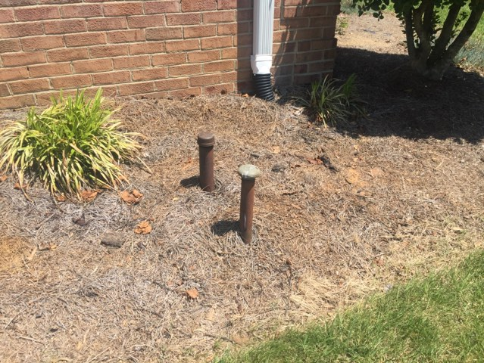
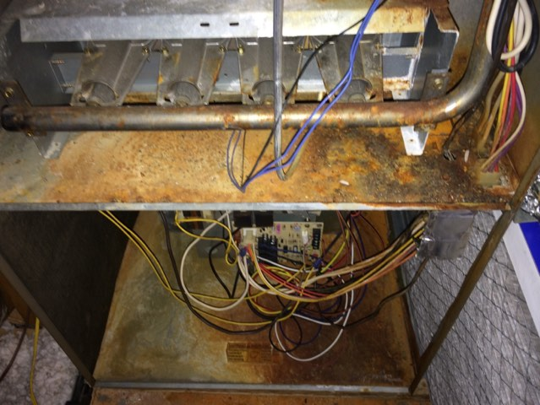
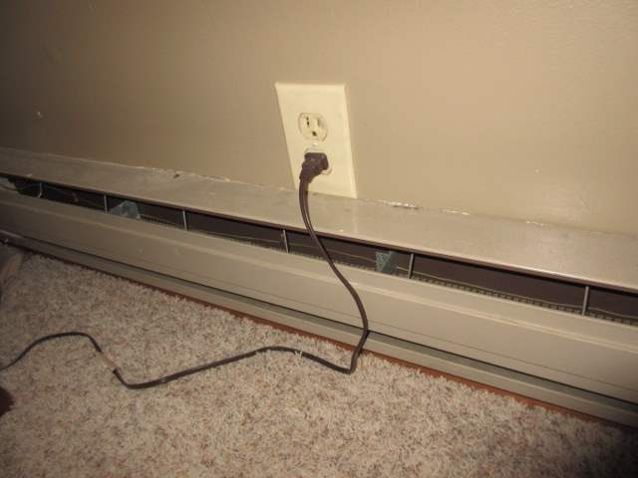
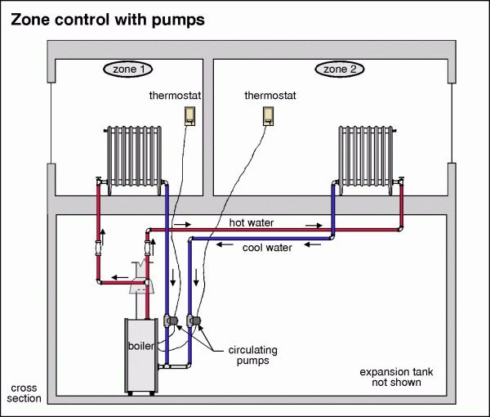
Common Heating System Defects
(常見供暖系統毛病)
Buried oil tank (地下油缸)
Old/rusty furnace (陳舊/生銹火爐)
Outlet above electric heater (插座位於電爐上)
Zone valve inoperative (區域閥損壞)

Slide 21
Cooling Systems (空調系統)
Air Conditioning System (空調系統)
Heat Pump (熱泵系統)
Outdoor Unit (室外部件)
Indoor Unit (室內部件)
Refrigerant Lines (製冷劑管道)
Ducts and Registers (風槽/風咀)

Slide 22
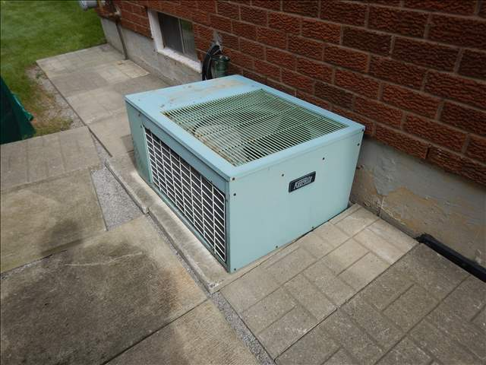
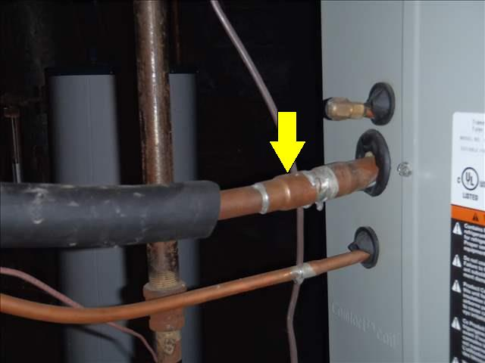


Common Cooling System Defects
(常見空調系統毛病)
Old air-conditioning unit (陳舊空調機)
Insulation missing (液體喉缺少保温)
Dryer exhaust too close (乾衣機排氣口太近)
Condensate drain blocked (冷凝排水淤塞)

Slide 23
Plumbing Systems (水務系統)
Water Supply/Distribution Systems
(供水/配水系統)
Fixtures and Faucets (水務裝置及喉具)
Drain, Waste & Vent Systems (排污系統)
Water Heating Equipment (熱水爐)
Pumps (水泵)
Exhaust Fans (抽氣扇)

Slide 24




Common Plumbing System Defects
(常見水務系統毛病)
Polybutylene (Poly-B) piping (聚丁烯喉管)
Old copper piping (陳舊銅喉管)
Old water heater (陳舊熱水器)
Bathtub tile loose (浴缸瓷磚鬆脫)

Slide 25

Insulation Systems (保温系統)
Attic/Flat Roof Insulation (閣樓/平屋頂保温)
Attic Ventilation (閣樓通風)
Air/Vapour Barrier (空氣/水蒸氣阻隔層)
Wall Insulation (外牆保温)
Floor Insulation (above unheated area)
(地板保温 (位於無暖氣地方之上方)
Crawlspace Ventilation (矮土庫通風)

Slide 26




Common Insulation Defects
(常見保温毛病)
Vermiculite insulation (蛭石保温)
Inadequate insulation (保温不足夠)
Insulation voids and gaps (保温空隙)
Attic mold (閣樓發霉)

Slide 27
Interior Systems (內部系統)
Ceilings/Walls/Floors (天花/牆壁/地板)
Steps/Stairways/Railings (梯級/樓梯/圍欄)
Countertops/Cabinets (檯面/牆櫃)
Doors/Windows (門/窗)
Fireplace/Wood Stove (壁爐/火爐)
Basement (土庫)
Crawlspace (矮土庫)

Slide 28




Common Interior System Defects
(常見內部系統毛病)
Ceiling stains (天花水漬)
Wall water damage (牆身損害)
Stairs handrail missing (樓梯沒有扶手)
Window lost seal (窗門密封失效)

Slide 29

Enjoy Your Home
安 享 家 樂

